Slide 1

SARS Covid 2 Detection through AI
CS 691

Slide 2

AGENDA
By examining patient records, symptom data, and medical imaging, artificial intelligence (AI)
can be utilized to identify SARS-CoV-2.
In medical imaging, AI algorithms are able to identify patterns that are consistent with COVID-
19 infections.
Large datasets can be used to train machine learning models to look for SARS-CoV-2 infection-
related patterns.
SARS-CoV-2 detection can be made more accurate and quick using AI-based detection.
Healthcare practitioners may benefit from faster and more accurate diagnoses thanks to AI-
based SARS-CoV-2 detection.

Slide 3

Team Members Roles
Vamshi
Project Manager
Venkatesh
Quality Analyst
Hanith
Tester

Slide 4

Team Members Roles
Anusha Nunna
Developer
Reshma Gonu
Developer
Alekhya
Facilitator

Slide 5

PROBLEM STATEMENT
v One of the basic moves toward containing viral
spread is the convenient discovery of positive
cases locally. Right now, numerous nations of
the world, including USA. Subsequently, for
defeating this issue, we have proposed a
model, which can proficiently order the
Coronavirus positive and negative cases well
development in time.
v In this way, gave the issue, the undertaking is
to characterize individuals as Coronavirus
positive or Coronavirus negative by utilizing a
reasonable Mechanized AI based model.

Slide 6

PROJECT DESCRIPTION
Identifying Coronavirus early may assist in
conceiving a fitting treatment with arranging and
illness control choices. In this review, we show how
move gaining from profound learning models can
be utilized to perform Coronavirus discovery
utilizing pictures from three most usually utilized
clinical imaging modes X-Beam, Ultrasound, and
CT filter. The point is to give over-focused clinical
experts a second sets of eyes through wise
profound learning picture characterization models.

Slide 7

PERSONAS
Stella
• Stella is a 27 years old
woman. She visited the
hospital for a checkup
because she wasn't feeling
well and to see if she was
exhibiting any covid
symptoms.
• She performed a CT scan
and obtained the results.
However, no doctors are
accessible to discuss the
papers and receive input.
• By using SARS Covid-19
Detection through AI, she can
upload the report in the
application and can get the
results.

Slide 8
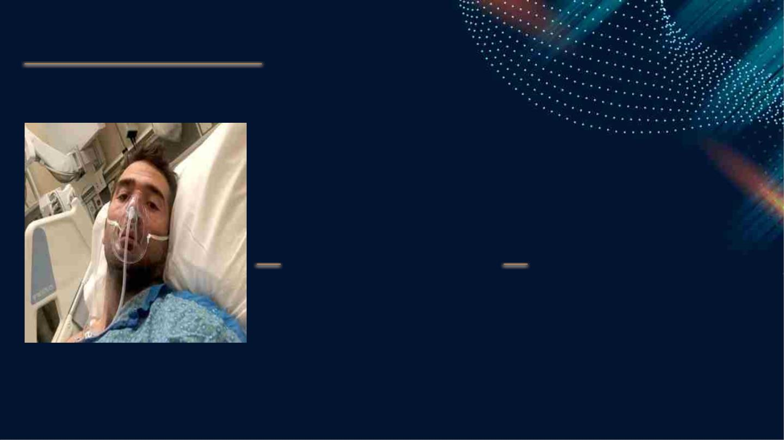
PERSONAS
Rishabh
• Rishabh is a 42 year old
man. He is affected with
Covid-19, and he needs to
take care of his health by
taking some remedies
from doctors.
• He can’t go out as he is
affected with covid-19.
Through SARS Covid-19
Detection through AI, he
can discuss his situation
through chatbot and get
suggestions from doctors.

Slide 9

PERSONAS
Richa
• Richa a 35 year old woman is
having covid-19 symptoms,
but she is not sure about that.
So, she want to test herself.
• Using SARS Covid-19
Detection through AI, she can
order a toolkit for testing.

Slide 10

TECHNOLOGY &
ALGORITHMS
Technology: Artificial Intelligence, Python
Algorithms: Resnet and transfer learning
Tools: Slack

Slide 11

TEAM WORKING AGREEMENT
Personal Interaction
The distribution of the work and levels of participation
Click here to view team consensus.
Managing conflicts
Others
Team members

Slide 12

RETROSPECTIVE
●
●
●
●
●
The project was initiated with a clear objective and
scope defined.
A team was formed, and roles and responsibilities
were assigned.
Planning was done to break down the project into
smaller tasks and set timelines.
Execution began with regular check-ins and
progress tracking.
Unforeseen challenges arose during the project,
which required adjustments and problem-solving.

Slide 13

RETROSPECTIVE
● Communication was crucial in keeping the team and
stakeholders informed about progress and any changes.
● The project was completed within the defined timeline,
scope, and budget.
● The project outcome was evaluated against the initial
objective to determine success.
● Lessons learned were documented for future reference
and to improve processes for future projects.
● The project team celebrated the successful completion
of the project and recognized team members for their
contributions

Slide 14
Group Wiki Page Link
https://github.com/htmw/2023S-Team4/wiki/CS-691

Slide 15

THANKING YOU

